Slide 1
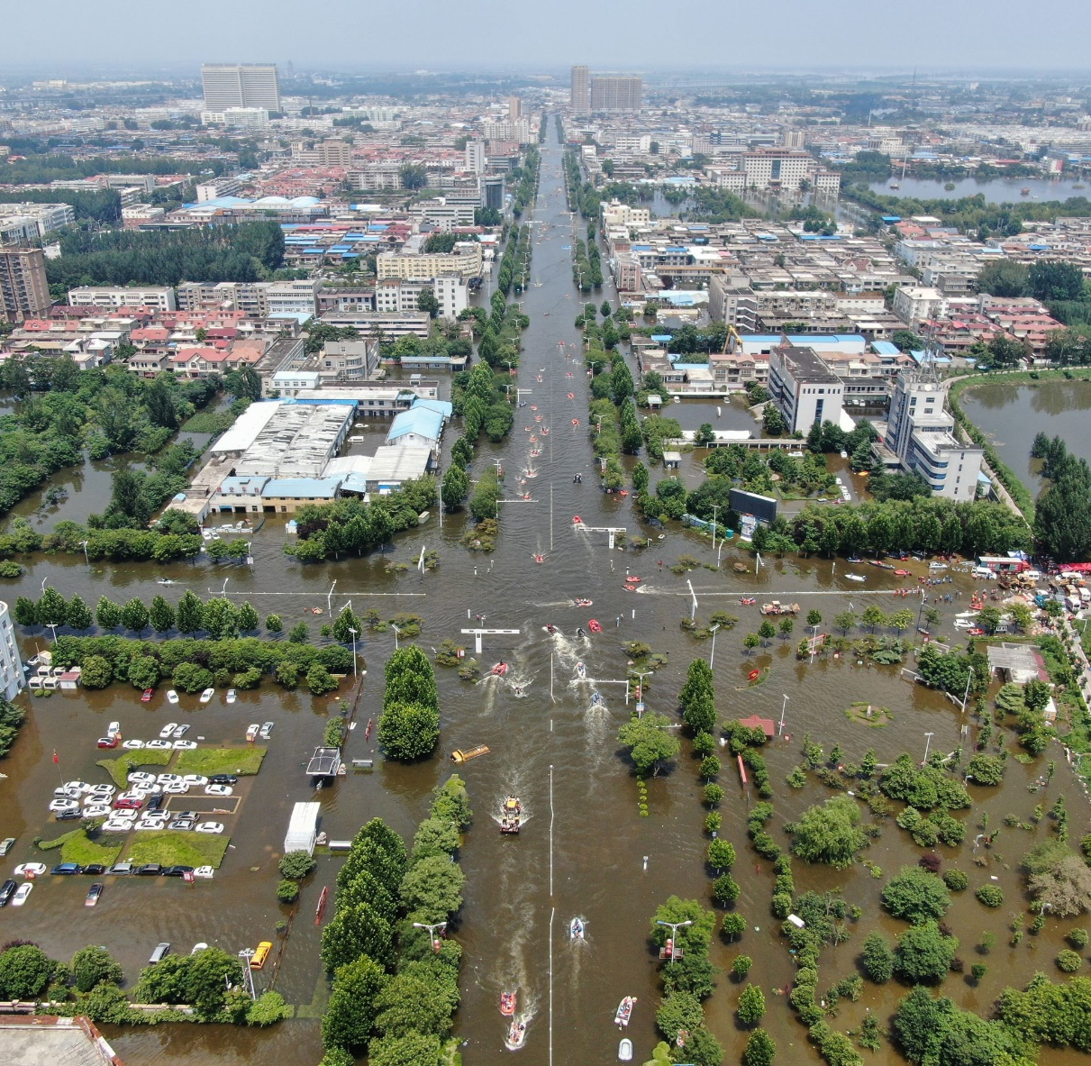



Identification of Flood Prone Area In Urban Settlement
Author 1
Photo
Author 3
Photo
Musmade Yash Sanjay
Ushir Om Mukund
Salve Rohit Anil
Sanjivani College of Engineering
Kopargaon Tal:Kopargaon Dist : Ahemadnagar
Prof.Umesh Sangule

Slide 2
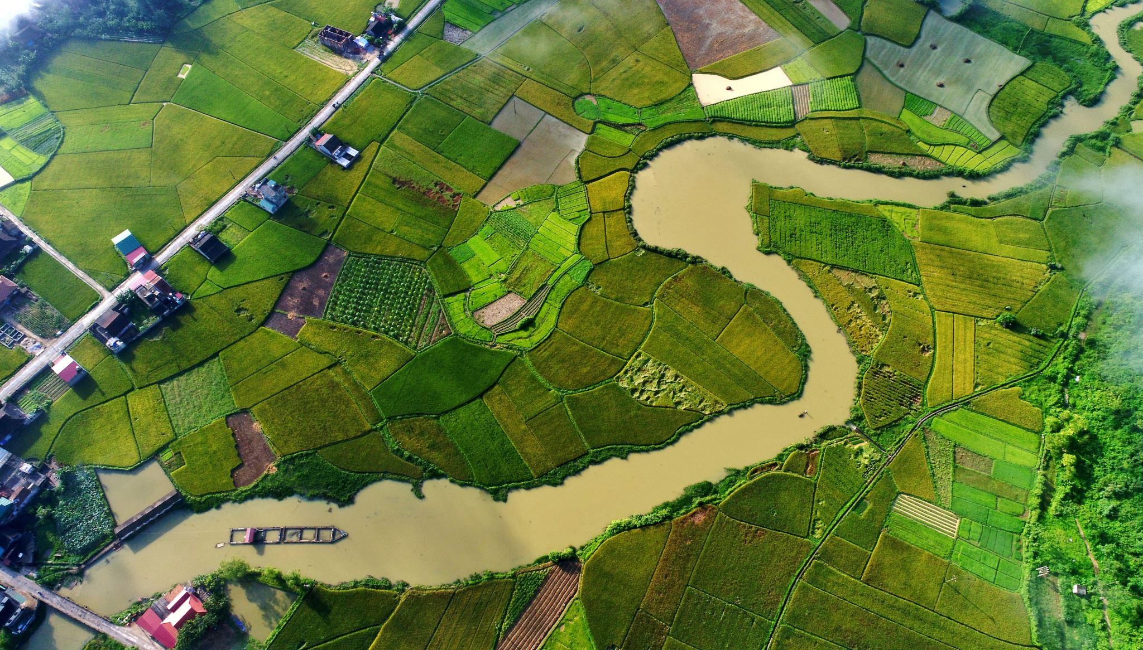
Challenge Statement
India regularly witnesses severe floods during the monsoon season. Monsoons are becoming more erratic because of climate change and global warming. Flood water can deviate from its usual course due to various factors, such as obstacles, urban development, landscap changes, etc. One of the challenge of Urban areas is to prepare for eventuality such as floods in NEW areas and having safety measures in place to protect human lives and at the same time restrict damages.

Slide 3
Concept / Solution
•Floods pose a significant risk to urban settlements, causing widespread damage to infrastructure, livelihoods, and posing a threat to human lives.
•Identifying flood-prone areas within urban settings is critical for effective disaster management and urban planning.
•This research paper aims to conduct a comprehensive analysis using geospatial techniques to identify and map flood-prone areas in urban settlements.
•The study employs a multi-tiered approach involving Geographic Information Systems (GIS), remote sensing, and hydrological modeling to analyze various factors that contribute to urban flooding.
•The primary objectives include Data Collection and Preprocessing ,Topographic Analysis ,Hydrological Modeling ,Vulnerability Assessment ,Mapping and Visualization .
•The research paper aims to provide urban planners, policymakers, and disaster management authorities with valuable insights for developing and implementing strategies to mitigate flood risks in urban areas.
•The outcomes of this study can assist in the formulation of effective land use planning, infrastructure development, and disaster preparedness measures to reduce the impact of floods on urban communities.

Slide 4

Pros and Cons of the solution
Pros | Cons
1. Effective Disaster Management | 1.Data Limitations
2.Informed Urban Planning | 2.Complexity of Models
3.Data-Driven Decision Making | 3.Cost and Resource Intensive
4.Vulnerability Assessment | 4.Dynamic Nature of Urban Environments
5.Public Safety | 5.Policy Implementation Challenges
6.Visualization for Communication | 6.Potential for Misinterpretation

Slide 5
Technical Description
This paper uses maps, satellite data, and computer models to find and map flood-prone areas in cities. The process involves collecting and analyzing data, assessing vulnerability, and creating informative maps.
By leveraging GIS tools, the study analyzes topographical features such as slope, elevation, and land cover to pinpoint areas susceptible to flooding. Hydrological models simulate water flow, considering factors like rainfall intensity, soil type, and land use.
The vulnerability assessment extends beyond physical factors, encompassing social, economic, and environmental dimensions, identifying vulnerable populations and critical infrastructure.
The spatial mapping and visualization phase integrates the analyzed data, providing a clear representation of flood-prone zones. The outcomes of this research aim to equip urban planners, policymakers, and disaster management authorities with actionable insights for developing strategies to mitigate flood risks in urban areas.
Recommendations include optimized land use planning, resilient infrastructure development, and enhanced disaster preparedness measures, contributing to more sustainable and resilient urban communities.

Slide 6
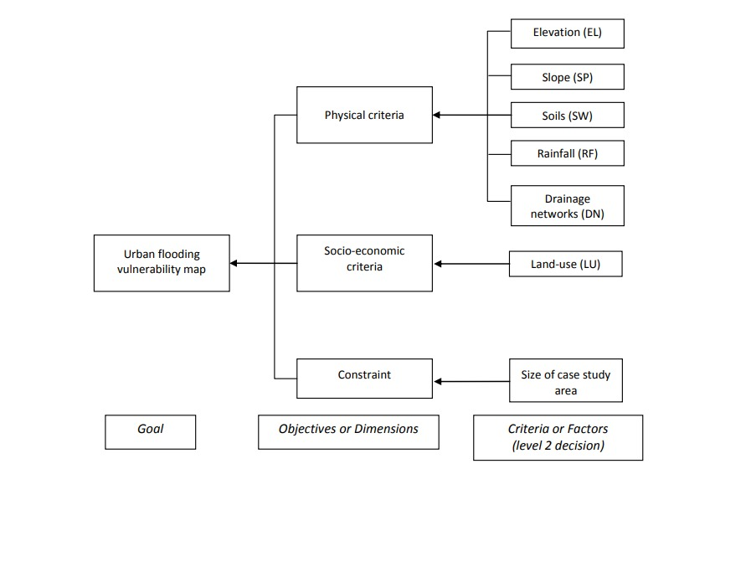
Implementation Plan
Urban Flooding Vulnerability Map
Physical Criteria
Socio-economic Criteria
Constraint
Elevation
Land Use
Size of case study area
Slope
Soils
Rainfall
Drianage networks

Slide 7
Validation
Urban areas face significant risks from floods, with potential repercussions on infrastructure, livelihoods, and human lives.
To address this challenge, this research paper employs a multi-tiered approach integrating Geographic Information Systems (GIS), remote sensing, and hydrological modeling to analyze factors contributing to urban flooding.
The primary objectives encompass data collection and preprocessing, topographic analysis, hydrological modeling, vulnerability assessment, mapping, and visualization.
These steps aim to provide valuable insights for urban planners, policymakers, and disaster management authorities.
The study's outcomes can inform strategies to mitigate flood risks through effective land use planning, infrastructure development, and disaster preparedness measures.
During the validation and testing phase, the research rigorously assesses data accuracy, model reliability, and vulnerability predictions.
Peer review and cross-validation with independent datasets contribute to the robustness of the findings. The research acknowledges limitations and uncertainties, ensuring transparency and enhancing the applicability of the results in diverse urban settings.

Slide 8
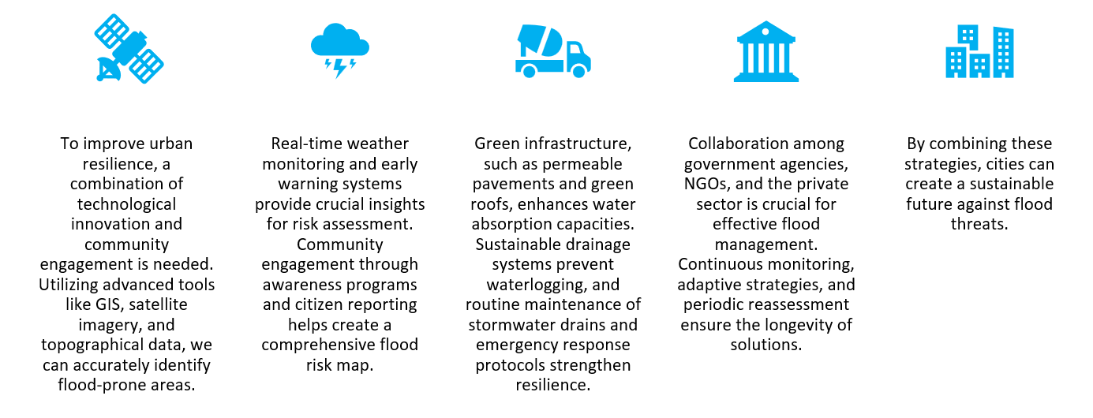
Analysis

Slide 9
Cost Estimate
QGIS software :-1.5-2L.
Development :- 4-5L .

Slide 10
Assumptions
This research paper aims to address the pressing issue of urban flooding by employing a robust, multi-tiered approach incorporating Geographic Information Systems (GIS), remote sensing, and hydrological modeling.
The study assumes the accuracy and reliability of the data utilized, including satellite imagery and hydrological information, as well as the validity of chosen hydrological models in representing real-world urban dynamics.
Implicit in the research is the stability of existing urban infrastructure, presupposing that drainage systems and related infrastructure are operational and minimally prone to changes or failures during the analysis period.
The assumption of climate stability and the exclusion of significant climate change effects during the study period underpin the analysis. Additionally, the study simplifies the complexity of urban development by assuming a certain level of homogeneity in development patterns and neglecting potential variations in land use, construction standards, and infrastructure quality across neighborhoods.
The assumptions also extend to the constancy of population density and land use patterns, disregarding potential changes during the analysis period.
The effectiveness of flood management policies and strategies is assumed to rely on successful governmental implementation, and human behavior, such as illegal construction or activities contributing to flooding, is assumed to remain constant or is adequately represented in the chosen models.
Lastly, the study assumes that urban planners and disaster management authorities have access to the necessary financial and technical resources for implementing proposed mitigation strategies. Transparently stating these assumptions is crucial for interpreting the research findings and understanding the limitations inherent in the study.

Slide 11
References
HYDRAULIC MODELING FRAMEWORK FOR URBAN FLOOD INUNDATION MAPPING OF GORAKHPUR CITY, INDIA
Urban Flood Vulnerability and Risk Mapping Using Integrated Multi-Parametric AHP and GIS: Methodological Overview and Case Study Assessment Yashon O. Ouma 1,* and Ryutaro Tateishi
Potential food‑prone area identifcation and mapping using GIS‑based multi‑criteria decision‑making and analytical hierarchy process in Dega Damot district, northwestern Ethiopia Ajanaw Negese1 · Dessalegn Worku1 · Alazar Shitaye1 · Haile Getne

Slide 12
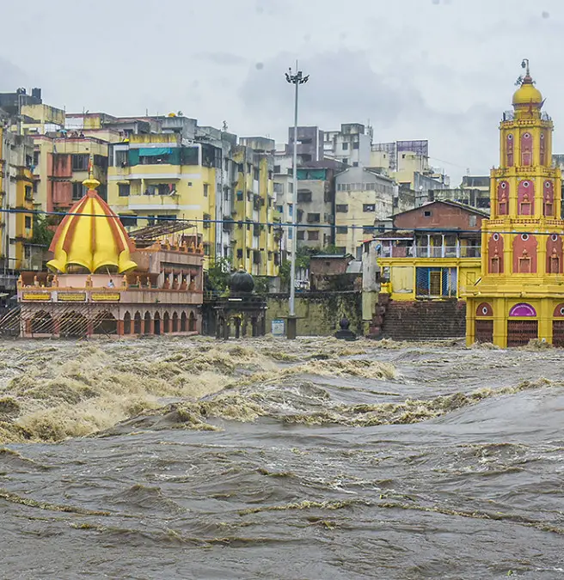
Thank You

